Slide 1

Working with Various Data Types
INT232

Slide 2
Working with Vectors
Suppose ‘x’ is a vector and ‘df’ is a data frame
X=c(a=1, b=2)
df=data.frame(x=1:3,y=5:7)
# TRUE
# TRUE
is.vector(x)
is.data.frame(df)

Slide 3
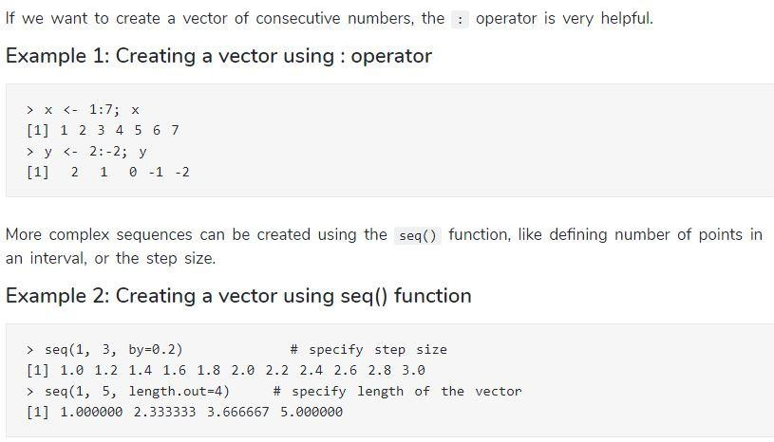

Slide 4
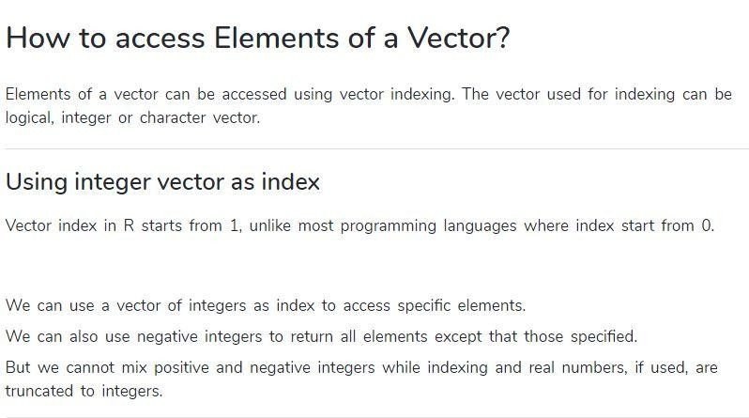

Slide 5
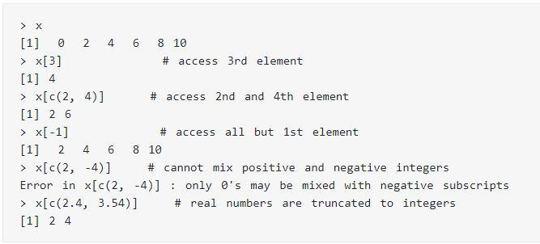

Slide 6
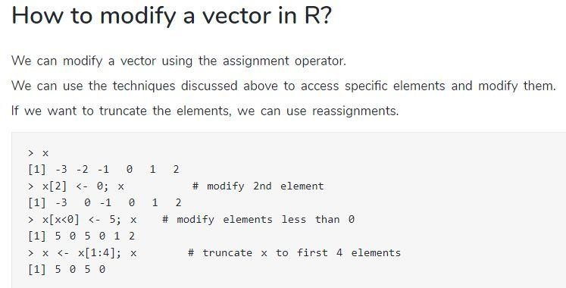

Slide 7
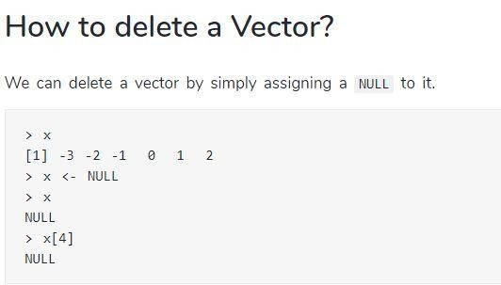

Slide 8
Working with List
#Create a list consisting of strings, numbers, vectors #and logical value:
List1 = list(“Hi”, “Hello”, c(10,20,30), TRUE, 12.34, 514.34)
Print(list1)

Slide 9
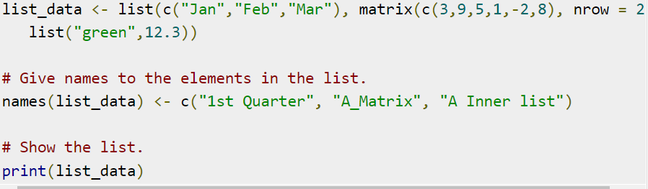
Naming a list element

Slide 10
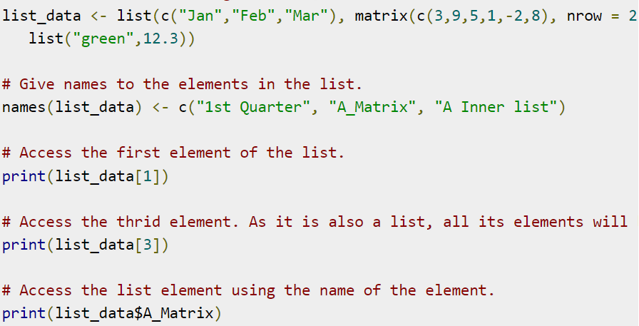
Accessing List Elements

Slide 11
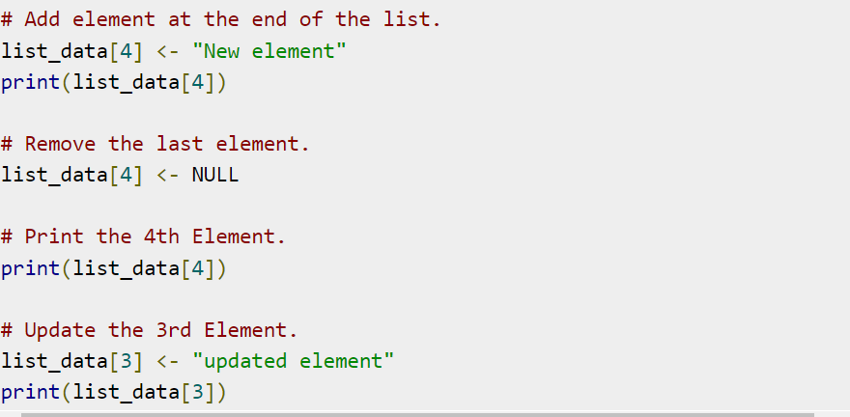
Manipulating List Elements

Slide 12
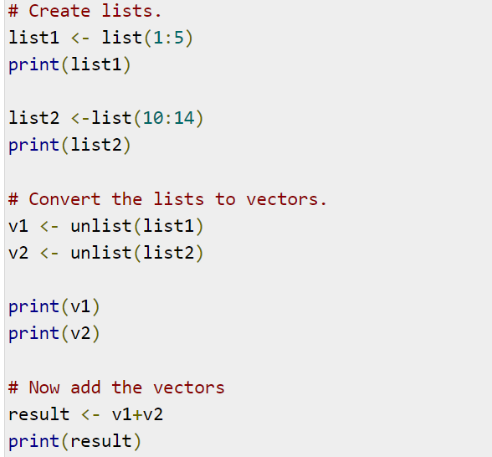
Converting List to Vector

Slide 13
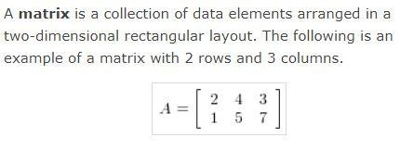
Working with matrices

Slide 14
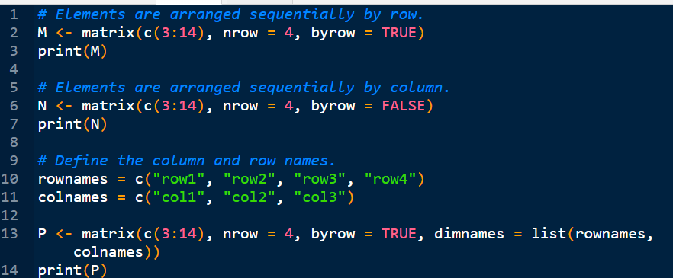

Slide 15
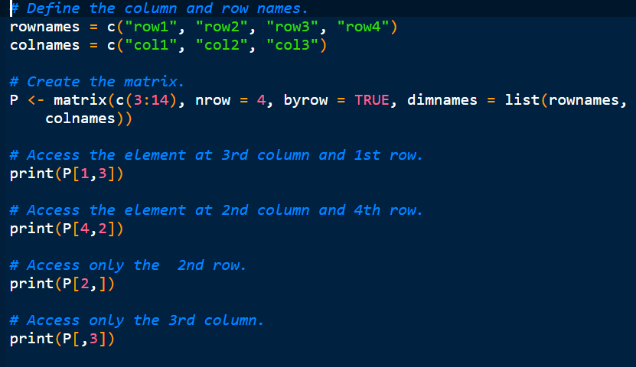
Accessing Elements of a Matrix

Slide 16
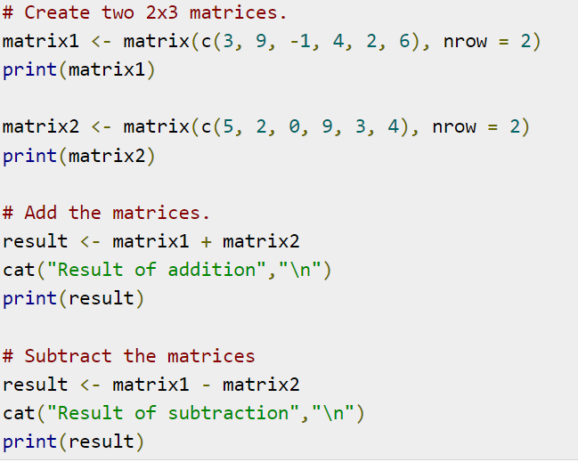
Matrix Addition & Subtraction

Slide 17
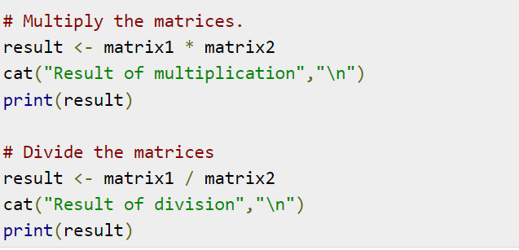
Multiplication & Division

Slide 18
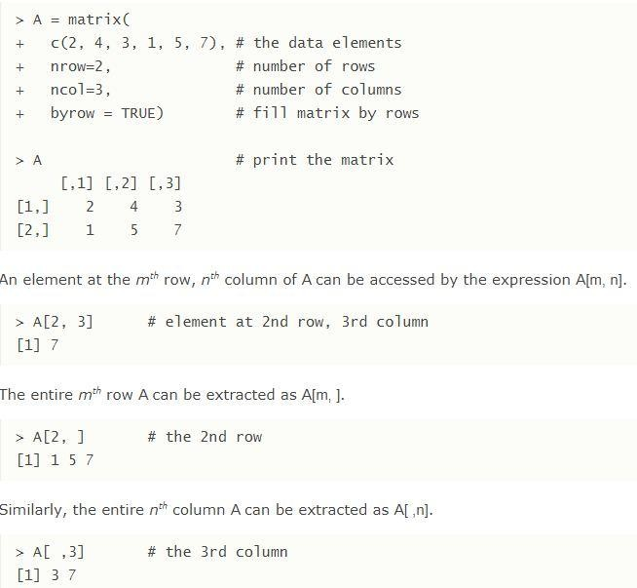

Slide 19
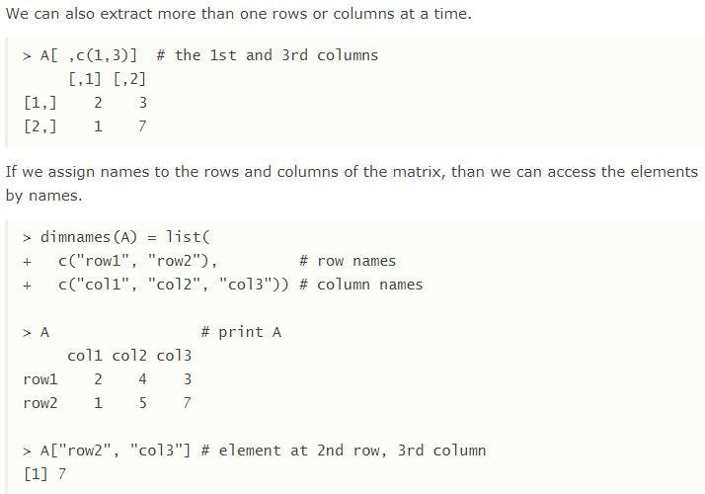

Slide 20
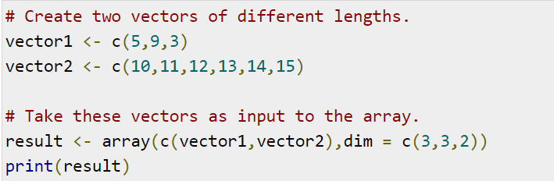
Working with Arrays

Slide 21
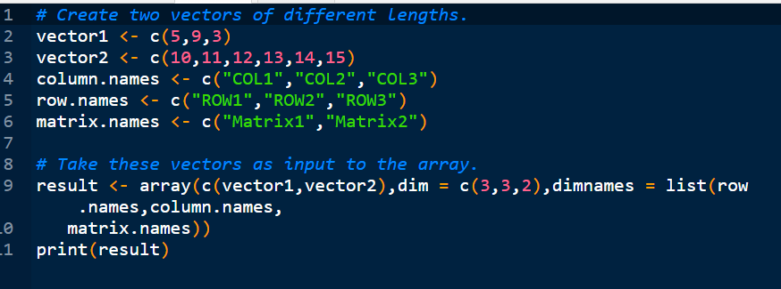
Naming Columns and Rows

Slide 22
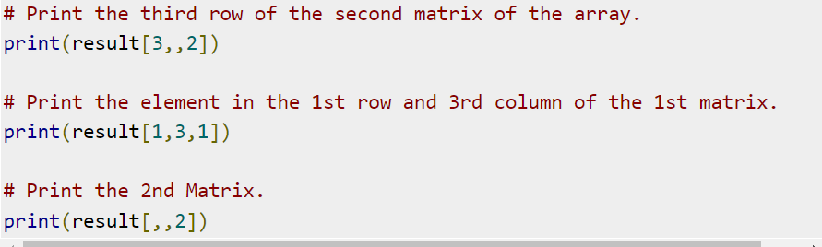
Accessing Array Elements

Slide 23
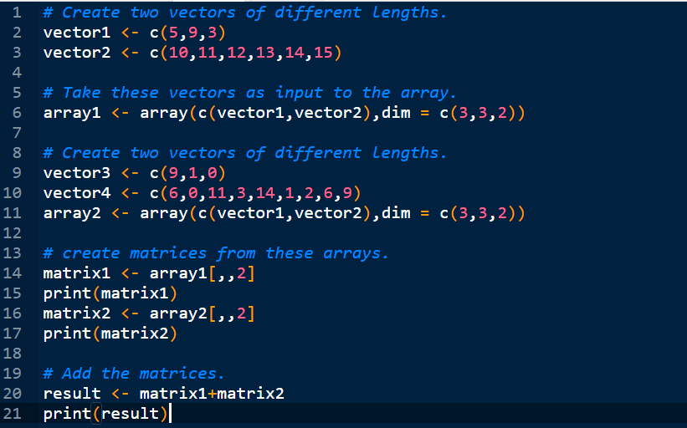
Manipulating Array Elements

Slide 24
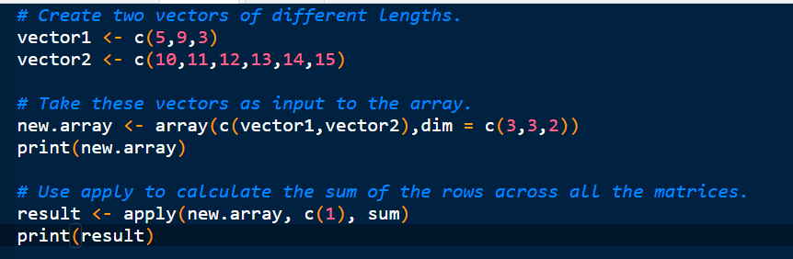
Calculations Across Array Elements

Slide 25
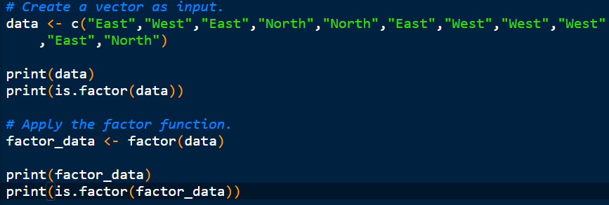
Working with Factors

Slide 26
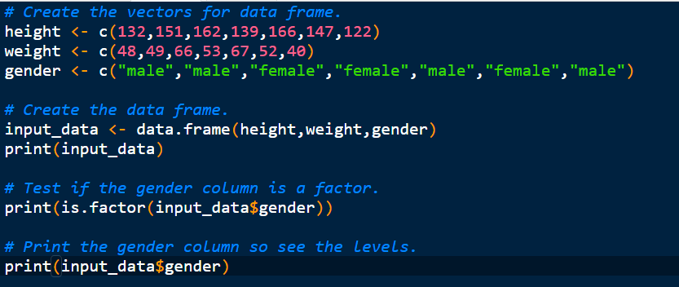
Factors in Data Frame

Slide 27
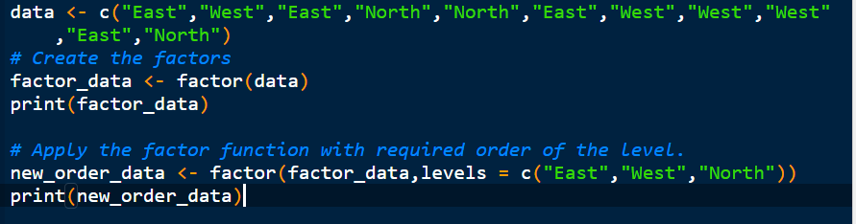
Changing the factor levels

Slide 28
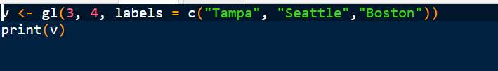
Generating Factor Levels

Slide 29
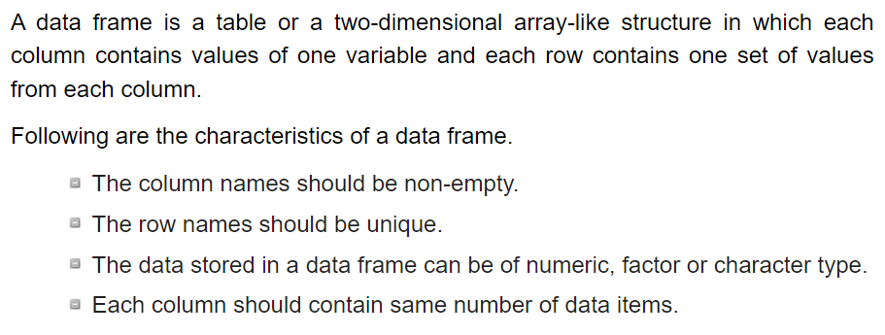
Working with Data Frames

Slide 30
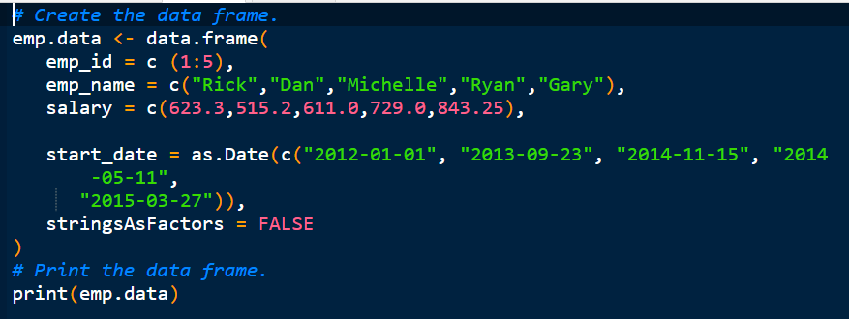

Slide 31
Get the structure and summary of Data Frame
To get the structure of the data frame, use str function:
Str(emp.data)
To get the summary of the dataframe, use summary function:
Summary(emp.data)

Slide 32
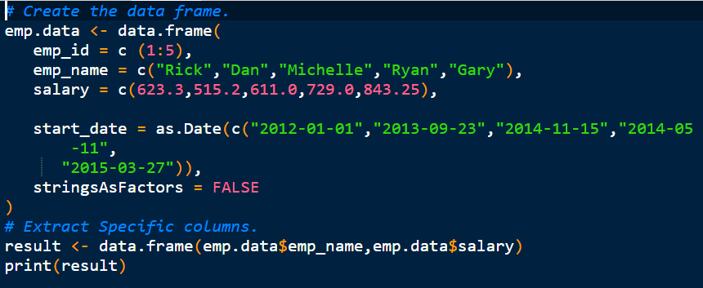
Extract data from Data Frame

Slide 33
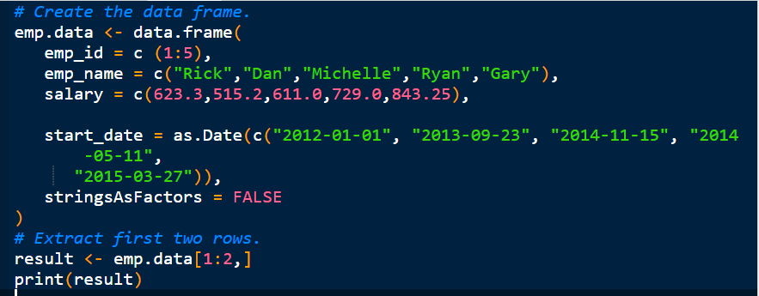

Slide 34
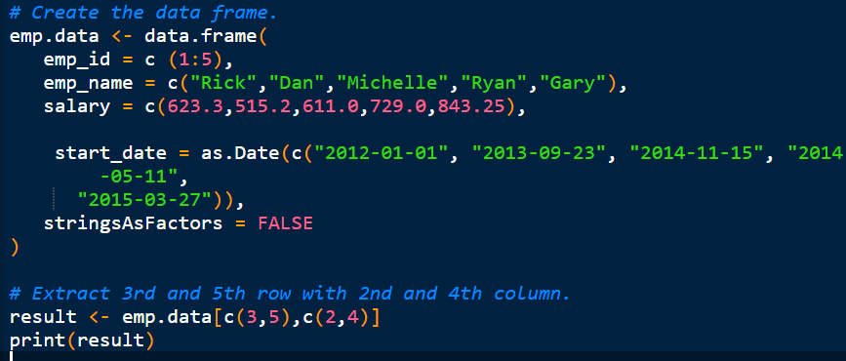

Slide 35
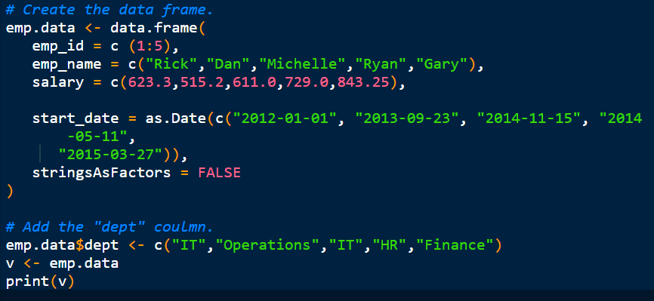
Add Column

Slide 36
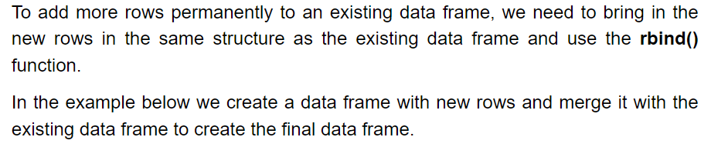
Add Row

Slide 37
